Slide 1

Smart Restaurant Choice
Submitted By:
Nikhil SK( 1BM18IS058)
Pramila Dalavai ( 1BM18IS068 )

Slide 2
TABLE OF CONTENTS
01
02
03
04
PROBLEM STATEMENT
OBJECTIVE
ANALYSIS AND APPROACH
CONCLUSION

Slide 3

PROBLEM STATEMENT
Bengaluru is best place for foodies. The number of restaurant are increasing day by day. Currently which stands at approximately 12,000 restaurants.
With such an high number of restaurants , the key issue that continue to pose a challenge for customers to decide menus , cuisine , cost etc.
Our proposed project will help the users to find right restaurant based on their inputs and also filter similarity between neighbourhoods of bangalore on the basis of food.

Slide 4

OBJECTIVE
So , what is the problem here? The never ending choice of food that we have. Hence, we have come up with a solution where.
We are creating a Python application using a cassandra DB and help the customer decide his choice of food based on a number of parameters.

Slide 5
OUR PLANS
STEP 1
STEP 2
Establishing Connection with Cassandra
Verifying Connection With
Database
STEP 3
STEP 4
Analysis
Results with visualization

Slide 6
56,567
Dataset

Slide 7
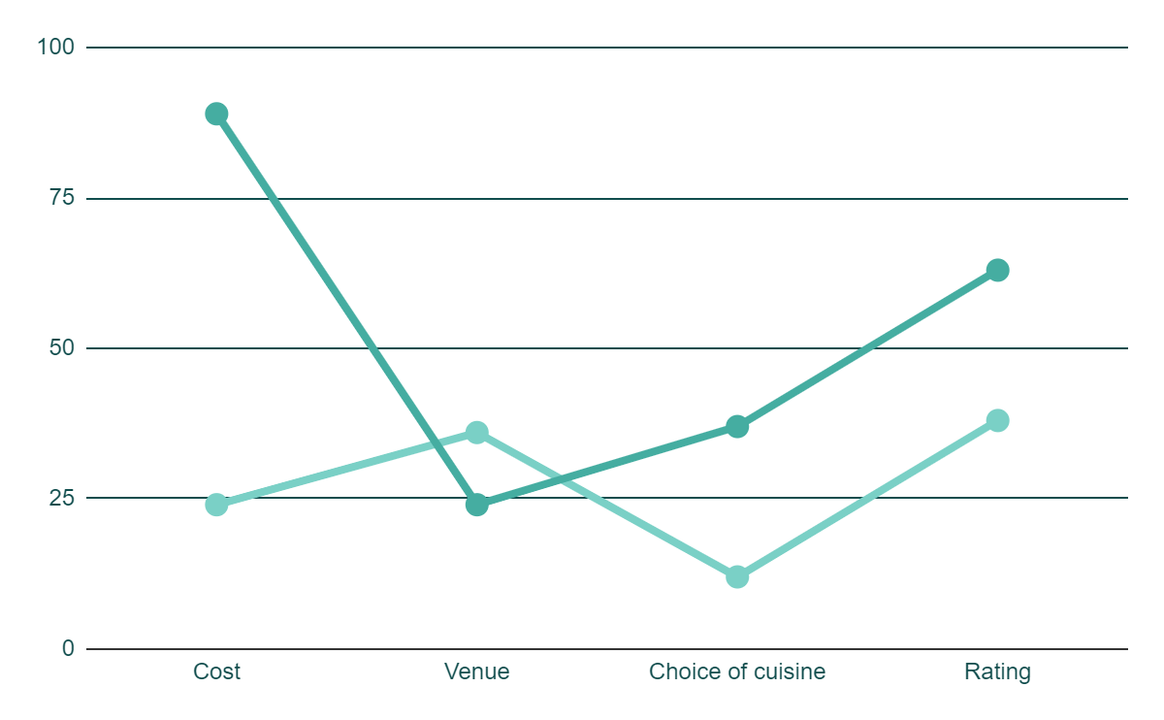
BIG DATA VISUALISATION
Seaborn
Matplotlib
Ipywidgets
Interact
User Interface

Slide 8
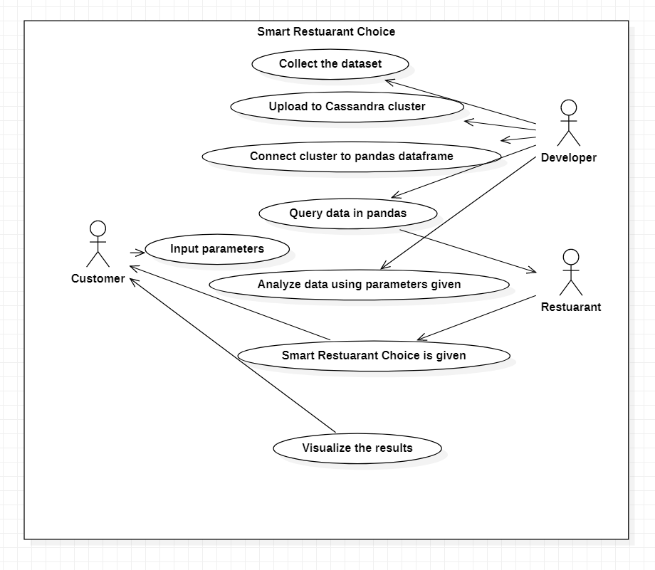
High Level Design

Slide 9
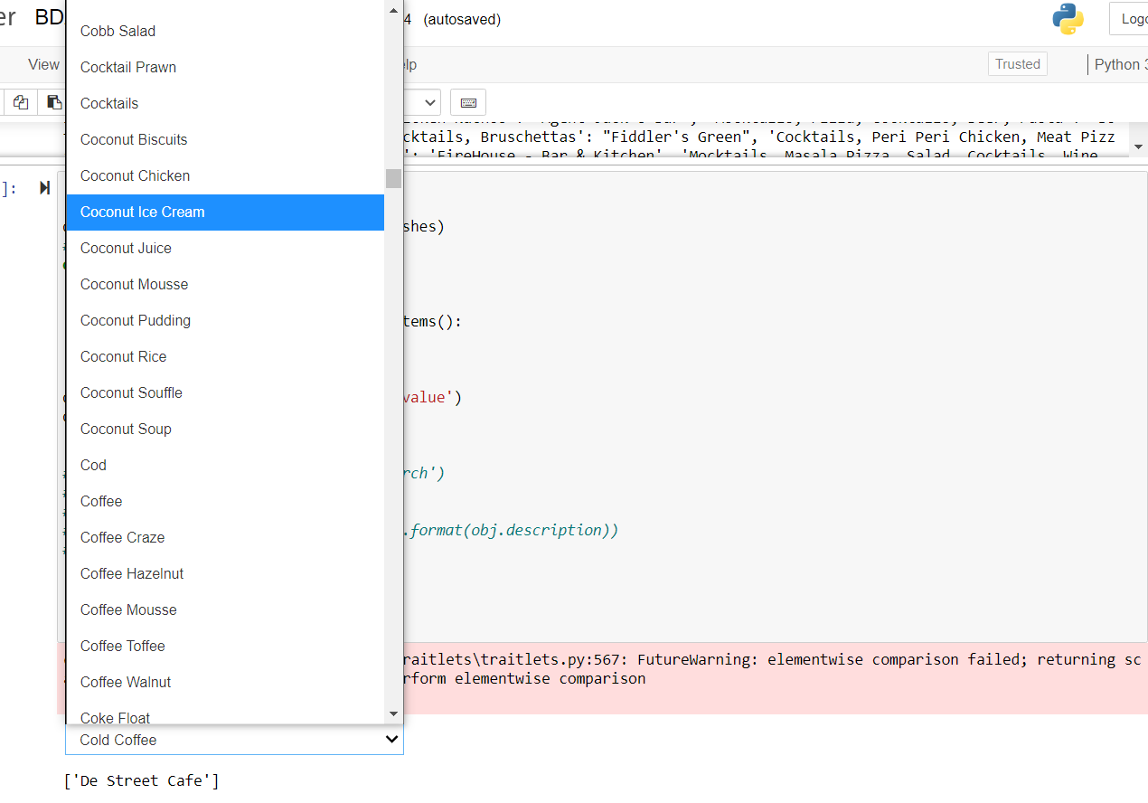
Query Results
Our application showing which restaurant to choose from
User Input : Dish name
Output : List of restaurants to choose from

Slide 10
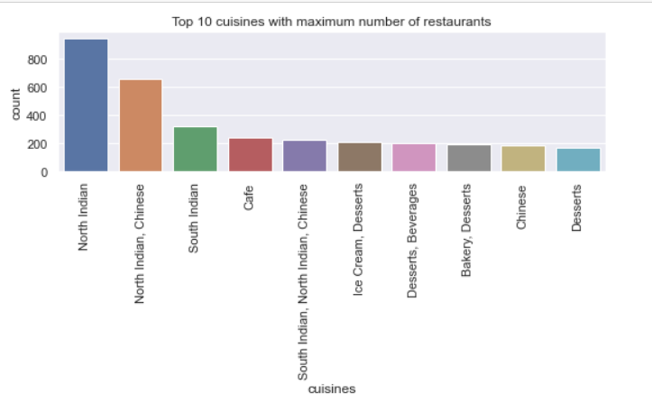
Visualisating data

Slide 11
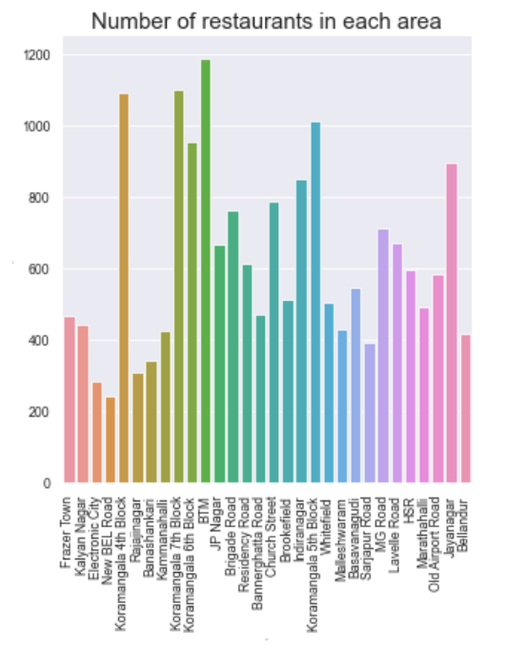
Visualisating data

Slide 12
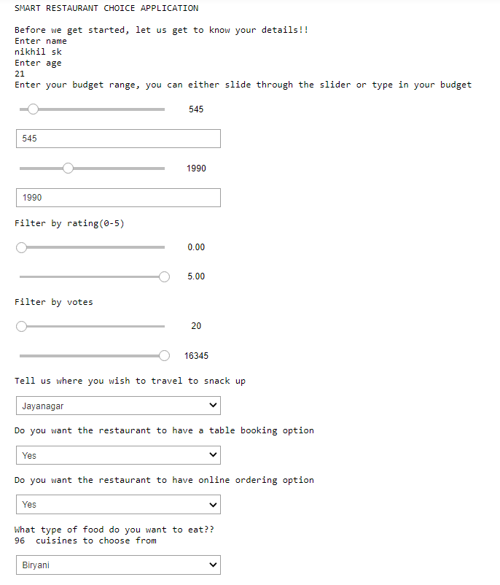
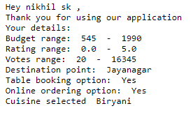
Application input from user
Taking user input parameters

Slide 13
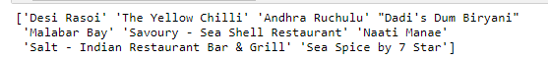
Application Results

